Slide 1
Finding a percentage with a multiplier
Understanding multiplicative relationships: percentages and proportionality

Slide 2
how to use Oak lessons

Slide 3
I can find a percentage of a quantity using a multiplier.

Slide 4
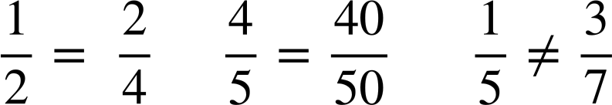
Two fractions are equivalent if they have the same value.
Example
Example
Non Example

Slide 5
The associative law states that a repeated application of the operation produces the same result regardless of how pairs of values are grouped. We can group using brackets.
Examples
Non examples
(3 + 4) + 10 =
(48 ÷ 6) ÷ 2 =
4
17
24 ÷ 6
7 + 10
3 + (4 + 10) =
3 + 14
48 ÷ (6 ÷ 2) =
16
17
48 ÷ 3

Slide 6

Finding a percentage with a multiplier
Reviewing percentages of amounts
Using a decimal multiplier

Slide 7
Reviewing percentages of amounts
We can find any percentage of an amount using a double number line.
Let’s look at 42% of 340
Firstly, draw the number line, indicating 100% is 340
100%
0%
Percentage
Amount
0
340

Slide 8
Reviewing percentages of amounts
We can also find any percentage of an amount using a double number line.
Let’s look at 42% of 340
Finding 10% is usually helpful. How do you think we can find 10%?
÷ 10
10%
100%
0%
Percentage
Amount
0
34
340
÷ 10

Slide 9
Reviewing percentages of amounts
Let’s look at 42% of 340
A strategy to find 42% is to find 40% and 2% and sum.
How would you find 40%?
× 4
10%
40%
100%
0%
Percentage
Amount
0
34
136
340
× 4

Slide 10
Reviewing percentages of amounts
Let’s look at 42% of 340
How would you find 2%?
÷ 5
2%
10%
40%
100%
0%
Percentage
Amount
0
6.8
34
136
340
÷ 5

Slide 11
Reviewing percentages of amounts
We can also find any percentage of an amount using a double number line.
What is 42% of 340?
136 + 6.8 = 142.8
2%
40%
100%
0%
Percentage
Amount
0
6.8
136
340

Slide 12
Reviewing percentages of amounts
Having a strategy to find a percentage of an amount is important. Finding 10%, 5% and 1% can generally help.
42%
100%
0%
Percentage
Amount
0
142.8
340

Slide 13
Reviewing percentages of amounts
Using a double number line, work out 36% of 460
× 7
1%
100%
5%
10%
35%
0%
Percentage
Amount
0
4.6
23
46
161
460
× 7
Lots of different ways using double number lines, but identifying 10%, 5% or 1% can help.
For example, 35% + 1% = 36% so 23 × 7 + 4.6 = 165.6

Slide 14
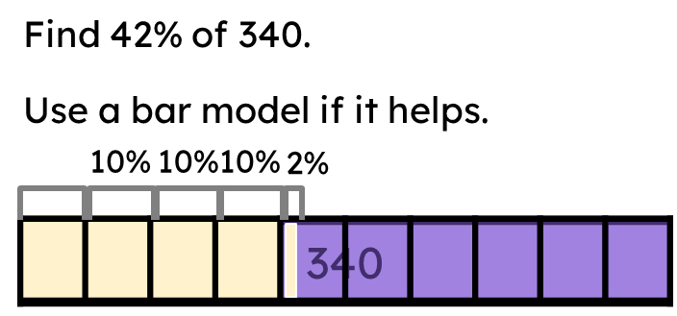
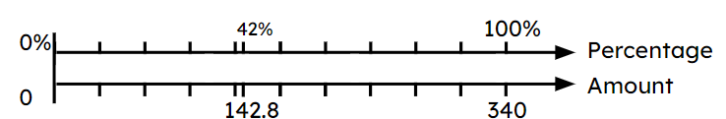
Reviewing percentages of amounts
Ratio tables can show the same information as a bar model and double number line.
Let’s look at 42% of 340 again.
Amount | %
340 | 100%
We know 100% is 340

Slide 15
Reviewing percentages of amounts
Ratio tables can show the same information as a bar model and double number line.
Let’s look at 42% of 340 again.
How do you think we can find 10%?
Amount | %
340 | 100%
How do you think we can find 1%?
Given this, what strategy would you use to find 42% of 340?
÷10
÷10
34 | 10%
÷10
÷10
3.4 | 1%
×4
×4
E.g 40% + 2% = 136 + 6.8 = 142.8
×2
136 | 40%
×2
136 | 40%
6.8 | 2%
6.8 | 2%

Slide 16
Reviewing percentages of amounts
It does not matter which method you prefer, but some take a little longer than others. Fundamentally, finding 10%, 5% and 1% generally helps.
Amount | %
340 | 100%
34 | 10%
3.4 | 1%
136 | 40%
6.8 | 2%
142.8 | 42%

Slide 17
Reviewing percentages of amounts
Using a ratio table, work out 23% of 840
Amount | %
840 | 100%
Show working out if it helps
÷10
8
0.4
÷10
84 | 10%
÷10
3
24 | 1.2
÷10
8.4 | 1%
×2
×2
×3
×3
168 | 20%
25.2 | 3%
193.2 | 23%

Slide 18
Reviewing percentages of amounts
Without a calculator, work out:
51% of 980 =
23% of 640 =
62% of 120 =
13% of 140 =
3% of 40 =
9% of 24 =

Slide 19
Reviewing percentages of amounts
Without a calculator, work out:
51% of 980 =
23% of 640 =
62% of 120 =
13% of 140 =
3% of 40 =
9% of 24 =
499.8
147.2
74.4
18.2
1.2
2.16

Slide 20
Finding a percentage with a multiplier
Reviewing percentages of amounts
Using a decimal multiplier

Slide 21
Using a decimal multiplier
Without a calculator, work out 68% of £430
Here’s one way you might work this out:
Percentage | Amount (£)
100% | 430
50% | 215
10% | 43
1% | 4.30
2% | 8.60
Now, using a calculator, work out the answer to:
0.68 × 430
You should get 292.4
What do you notice?
Why does this calculation give the same answer?
50% + 10% + 10% − 2% = 68%
£215 + £43 + £43 − £8.60 = £292.40

Slide 22
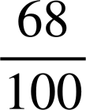
Using a decimal multiplier
Let’s look at why that works.
For example, finding 68% of £430
We know that finding percentages of a given amount is like finding a fraction of an amount:
68% of 430 = of 430
When finding fractions of amounts we use multiplication in place of the ‘of’
68% of 430 = × 430
This must be equivalent to 0.68 × 430 since 0.68 is the decimal equivalent to

Slide 23
Using a decimal multiplier
Work out the decimal equivalent to the following percentages:
26%
89%
54%
3%
2%
5.8%
= 0.26
= 0.89
= 0.54
= 0.03
= 0.02
= 0.058

Slide 24
Using a decimal multiplier
Pair up the question with the correct decimal multiplication.
0.042 × 600
24% of 600
42% of 600
0.024 × 600
4.2% of 600
0.24 × 600
2.4% of 600
0.42 × 600

Slide 25
Using a decimal multiplier
Recognising that we can calculate a percentage of an amount using a decimal multiplier simplifies the questions and working out, especially if we have a calculator.
For example,
Work out 24% of 182
What would this be using a decimal multiplier?

Slide 26
Using a decimal multiplier
Recognising that we can calculate a percentage of an amount using a decimal multiplier simplifies the questions and working out, especially if we have a calculator.
For example,
Work out 24% of 182 = 0.24 × 182

Slide 27
Using a decimal multiplier
Work out 24% of 182 = 0.24 × 182
You can still work this out using a written method.
✕ | 20 | 4
100 | 2000 | 400
80 | 1600 | 320
2 | 40 | 8
✕ | 20 | 4
100
80
2
E.g. Using the associative law
0.24 × 182 = 24 × 182 × 0.01
2000
400
= 4368 × 0.01
1600
320
= 43.68
40
+ 8
24% of 182 = 43.68
4368

Slide 28
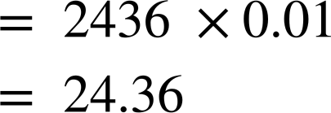
Using a decimal multiplier
Here is Jun’s working out for 3% of 812.
Where did he make his mistake? What did he calculate?
✕ | 3
800 | 2400
10 | 30
2 | 6
2400
30
+ 6
2436
The decimal calculation should be 0.03 × 812 = 3 × 812 × 0.001
Jun has worked out 30% of 812, not 3%

Slide 29
Using a decimal multiplier
Write the calculation showing the decimal multiplier. You do not need to calculate the answer.
56% of 389
24% of 484
16% of 563.1
3% of 186.2
33.3% of 475
3.3% of 986

Slide 30
Using a decimal multiplier
2) Work out:
a) 27% of 560
b) 18% of 244
c) 6% of 94

Slide 31
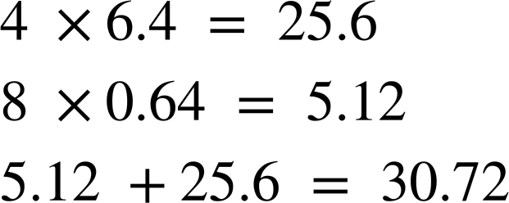
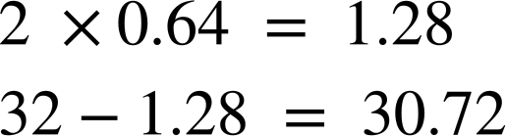
Using a decimal multiplier
3) Can you explain the strategy behind each student’s working out for finding 48% of 64?
Alex
Sam

Slide 32
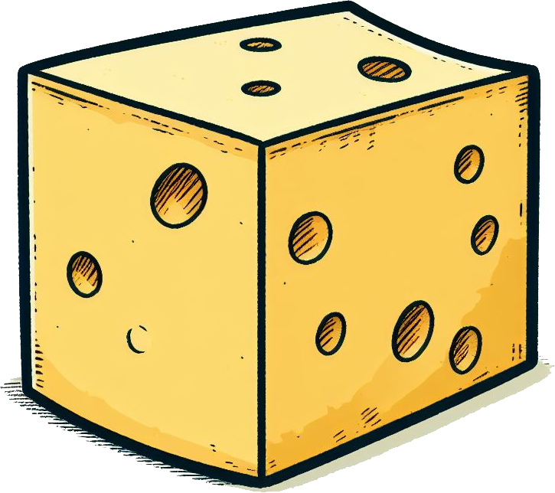
Using a decimal multiplier
4) A hard cheddar cheese contains 37% water, 33% fat, 23% protein, 3.5% carbohydrates, and 3.5% minerals and other compounds.
From a 250g block of cheese, work out how many grams there are of:
Water
Fat
Protein

Slide 33
Using a decimal multiplier
Write the calculation showing the decimal multiplier. You do not need to calculate the answer.
56% of 389
24% of 484
16% of 563.1
3% of 186.2
33.3% of 475
3.3% of 986
= 0.56 × 389
= 0.24 × 484
= 0.16 × 563.1
= 0.03 × 186.2
= 0.333 × 475
= 0.033 × 986

Slide 34
Using a decimal multiplier
2) Work out:
a) 27% of 560
b) 18% of 244
c) 6% of 94
= 0.27 × 560 = 151.2
= 0.18 × 244 = 43.92
= 0.06 × 94 = 5.64

Slide 35
Using a decimal multiplier
3) Can you explain the strategy behind each student’s working out for finding 48% of 64?
Alex has found 10% and is multiplying by 4 to give 40%.
Then Alex has found 1% and is multiplying by 8 to give 8%.
He has then summed 40% and 8% to make 48% which is 30.72
Alex

Slide 36
Using a decimal multiplier
3) Can you explain the strategy behind each student’s working out for finding 48% of 64?
Sam has found 1% and is multiplying by 2 to give 2%.
The 32 represents 50% of the 64
Sam has subtracted 2% from 50% to make 48% which is 30.72
Sam

Slide 37
Using a decimal multiplier
4) A hard cheddar cheese contains 37% water, 33% fat, 23% protein, 3.5% carbohydrates, and 3.5% minerals and other compounds.
From a 250g block of cheese, work out how many grams there are of:
= 0.37 × 250 = 92.5 g
Water
Fat
Protein
= 0.33 × 250 = 82.5 g
= 0.23 × 250 = 57.5 g

Slide 38
Finding a percentage with a multiplier
We have looked at finding a percentage of an amount using: double number lines, bar models, ratio tables and using a decimal multiplier.
You can use an equivalent decimal multiplication to find percentages of amounts.
For example, 68% of 430 can be found by calculating 0.68 × 430
This is particularly efficient when using a calculator to work out percentages of amounts.

Slide 39

© Oak National Academy 2024.
Produced in partnership with Mathematics in Education and Industry.
Licensed on the Open Government Licence v3.0, except where otherwise stated. See Oak terms and conditions.

